Slide 1
CS 3050: Basic Concept of Algorithm
Dong Xu
Department of Electrical Engineering
and Computer Science
University of Missouri

Slide 2
Computational thinking
The application of computational processes/concepts/techniques to reason about problems in any field
  It is a way of thinking
  It provides an approach for:
    Framing questions
    Solving problems
    Gaining new insight
It is something people in many fields are already doing
  Biology: Understanding DNA
  Economics: Modeling financial systems
  Humanities: Mining crime databases

Slide 3
What is an algorithm?
  Most fundamental concept of CS is an algorithm: a set of steps that defines how a task is performed (computational thinking)
  An algorithm is instantiated in a program and then executed on a machine
Algorithms must:
1. Be well-ordered and unambigous
2. Be executable (understandable)
3. Solve the problem, and
4. Terminate.
Note: often the agent is a computer or a robot…

Slide 4
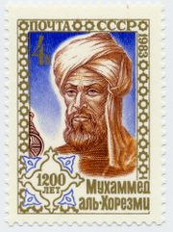
History of Algorithm
The earliest known algorithms were defined by
Greek mathematicians
  e.g. Euclid’s method for the greatest common
  divisor of two integers, ca. 300 BC
The modern word “algorithm” comes from the name of the Persian scholar Muḥammad ibn
Mūsā al-Ḵwārizmī (ca. 780 -- ca. 850)
  when his work was published in Latin his name
  was spelled Algoritmi
  he was the author of several influential works on
  mathematics and natural science
  his book on the systematic solution of linear
  equations contained several algorithms
  the title of this book is also the source of
  our word “algebra”

Slide 5
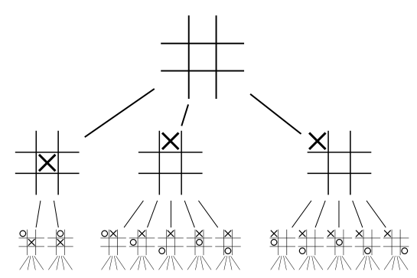
Algorithm: an example
255,168 possible games:
131,184: won by (X)
77,904: won by (O)
46,080: drawn
Tic Tac Toe
1-<number>

Slide 6
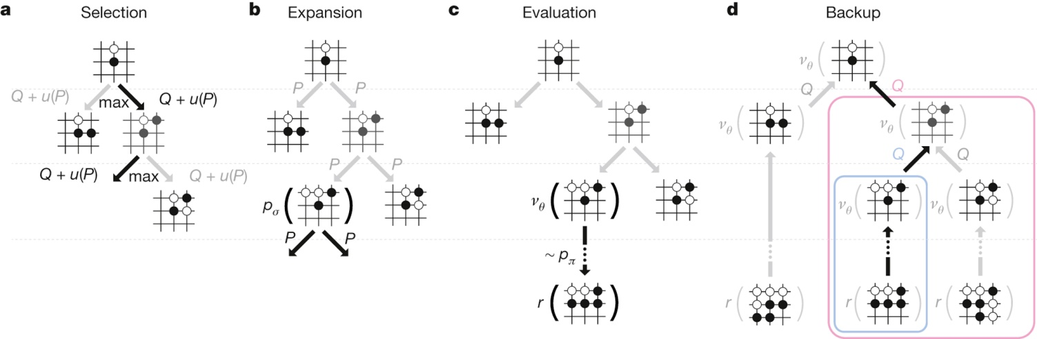

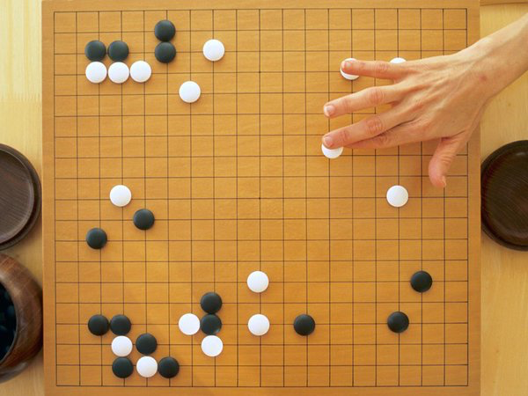
Google’s AlphaGo beated a top Go player Lee Se-dol
1-<number>

Slide 7
Brookshear's Diagram
architecture, operating systems,
networks,…
theory of computation,…
Limitations of
Execution of
Analysis of
Algorithm
Communication of
algorithmics,…
software engineering,…
Discovery of
Representation of
artificial intelligence,…
data structures, programming
language design,…
1-<number>

Slide 8
Schneider & Gersting's Diagram
Social Issues
artificial intelligence,…
Applications
programming langs,
compilers,…
The Software World
assemblers,
operating systems…
The Virtual Machine
computer
organization,…
The Hardware World
design & analysis
of algorithms,…
Algorithmic Foundations of CS
1-<number>

Slide 9
How to express algorithms?
Increasing precision
English
Pseudocode
Real programming languages
Ease of expression
Describe the ideas of an algorithm in English.
Use pseudocode to clarify sufficiently tricky details of the algorithm.

Slide 10
Sorting
Sorting takes an unordered collection and makes it an ordered one.
1 2 3 4 5 6
77
42
35
12
101
5
1 2 3 4 5 6
5
12
35
42
77
101

Slide 11
An Example: Insertion Sort
InsertionSort(A, n) {
for i = 2 to n {
key = A[i]
j = i - 1;
while (j > 0) and (A[j] > key) {
A[j+1] = A[j]
j = j - 1
}
A[j+1] = key
}
}
https://www.youtube.com/watch?v=ROalU379l3U

Slide 12
An Example: Insertion Sort
30
10
40
20
i = ∅ j = ∅ key = ∅
A[j] = ∅ A[j+1] = ∅
1
2
3
4
InsertionSort(A, n) {
for i = 2 to n {
key = A[i]
j = i - 1;
while (j > 0) and (A[j] > key) {
A[j+1] = A[j]
j = j - 1
}
A[j+1] = key
}
}

Slide 13
An Example: Insertion Sort
30
10
40
20
i = 2 j = 1 key = 10
A[j] = 30 A[j+1] = 10
1
2
3
4
InsertionSort(A, n) {
for i = 2 to n {
key = A[i]
j = i - 1;
while (j > 0) and (A[j] > key) {
A[j+1] = A[j]
j = j - 1
}
A[j+1] = key
}
}

Slide 14
An Example: Insertion Sort
30
30
40
20
i = 2 j = 1 key = 10
A[j] = 30 A[j+1] = 30
1
2
3
4
InsertionSort(A, n) {
for i = 2 to n {
key = A[i]
j = i - 1;
while (j > 0) and (A[j] > key) {
A[j+1] = A[j]
j = j - 1
}
A[j+1] = key
}
}

Slide 15
An Example: Insertion Sort
30
30
40
20
i = 2 j = 1 key = 10
A[j] = 30 A[j+1] = 30
1
2
3
4
InsertionSort(A, n) {
for i = 2 to n {
key = A[i]
j = i - 1;
while (j > 0) and (A[j] > key) {
A[j+1] = A[j]
j = j - 1
}
A[j+1] = key
}
}

Slide 16
An Example: Insertion Sort
30
30
40
20
i = 2 j = 0 key = 10
A[j] = ∅ A[j+1] = 30
1
2
3
4
InsertionSort(A, n) {
for i = 2 to n {
key = A[i]
j = i - 1;
while (j > 0) and (A[j] > key) {
A[j+1] = A[j]
j = j - 1
}
A[j+1] = key
}
}

Slide 17
An Example: Insertion Sort
30
30
40
20
i = 2 j = 0 key = 10
A[j] = ∅ A[j+1] = 30
1
2
3
4
InsertionSort(A, n) {
for i = 2 to n {
key = A[i]
j = i - 1;
while (j > 0) and (A[j] > key) {
A[j+1] = A[j]
j = j - 1
}
A[j+1] = key
}
}

Slide 18
An Example: Insertion Sort
10
30
40
20
i = 2 j = 0 key = 10
A[j] = ∅ A[j+1] = 10
1
2
3
4
InsertionSort(A, n) {
for i = 2 to n {
key = A[i]
j = i - 1;
while (j > 0) and (A[j] > key) {
A[j+1] = A[j]
j = j - 1
}
A[j+1] = key
}
}

Slide 19
An Example: Insertion Sort
10
30
40
20
i = 3 j = 0 key = 10
A[j] = ∅ A[j+1] = 10
1
2
3
4
InsertionSort(A, n) {
for i = 2 to n {
key = A[i]
j = i - 1;
while (j > 0) and (A[j] > key) {
A[j+1] = A[j]
j = j - 1
}
A[j+1] = key
}
}

Slide 20
An Example: Insertion Sort
10
30
40
20
i = 3 j = 0 key = 40
A[j] = ∅ A[j+1] = 10
1
2
3
4
InsertionSort(A, n) {
for i = 2 to n {
key = A[i]
j = i - 1;
while (j > 0) and (A[j] > key) {
A[j+1] = A[j]
j = j - 1
}
A[j+1] = key
}
}

Slide 21
An Example: Insertion Sort
10
30
40
20
i = 3 j = 0 key = 40
A[j] = ∅ A[j+1] = 10
1
2
3
4
InsertionSort(A, n) {
for i = 2 to n {
key = A[i]
j = i - 1;
while (j > 0) and (A[j] > key) {
A[j+1] = A[j]
j = j - 1
}
A[j+1] = key
}
}

Slide 22
An Example: Insertion Sort
10
30
40
20
i = 3 j = 2 key = 40
A[j] = 30 A[j+1] = 40
1
2
3
4
InsertionSort(A, n) {
for i = 2 to n {
key = A[i]
j = i - 1;
while (j > 0) and (A[j] > key) {
A[j+1] = A[j]
j = j - 1
}
A[j+1] = key
}
}

Slide 23
An Example: Insertion Sort
10
30
40
20
i = 3 j = 2 key = 40
A[j] = 30 A[j+1] = 40
1
2
3
4
InsertionSort(A, n) {
for i = 2 to n {
key = A[i]
j = i - 1;
while (j > 0) and (A[j] > key) {
A[j+1] = A[j]
j = j - 1
}
A[j+1] = key
}
}

Slide 24
An Example: Insertion Sort
10
30
40
20
i = 3 j = 2 key = 40
A[j] = 30 A[j+1] = 40
1
2
3
4
InsertionSort(A, n) {
for i = 2 to n {
key = A[i]
j = i - 1;
while (j > 0) and (A[j] > key) {
A[j+1] = A[j]
j = j - 1
}
A[j+1] = key
}
}

Slide 25
An Example: Insertion Sort
10
30
40
20
i = 4 j = 2 key = 40
A[j] = 30 A[j+1] = 40
1
2
3
4
InsertionSort(A, n) {
for i = 2 to n {
key = A[i]
j = i - 1;
while (j > 0) and (A[j] > key) {
A[j+1] = A[j]
j = j - 1
}
A[j+1] = key
}
}

Slide 26
An Example: Insertion Sort
10
30
40
20
i = 4 j = 2 key = 20
A[j] = 30 A[j+1] = 40
1
2
3
4
InsertionSort(A, n) {
for i = 2 to n {
key = A[i]
j = i - 1;
while (j > 0) and (A[j] > key) {
A[j+1] = A[j]
j = j - 1
}
A[j+1] = key
}
}

Slide 27
An Example: Insertion Sort
10
30
40
20
i = 4 j = 2 key = 20
A[j] = 30 A[j+1] = 40
1
2
3
4
InsertionSort(A, n) {
for i = 2 to n {
key = A[i]
j = i - 1;
while (j > 0) and (A[j] > key) {
A[j+1] = A[j]
j = j - 1
}
A[j+1] = key
}
}

Slide 28
An Example: Insertion Sort
10
30
40
20
i = 4 j = 3 key = 20
A[j] = 40 A[j+1] = 20
1
2
3
4
InsertionSort(A, n) {
for i = 2 to n {
key = A[i]
j = i - 1;
while (j > 0) and (A[j] > key) {
A[j+1] = A[j]
j = j - 1
}
A[j+1] = key
}
}

Slide 29
An Example: Insertion Sort
10
30
40
20
i = 4 j = 3 key = 20
A[j] = 40 A[j+1] = 20
1
2
3
4
InsertionSort(A, n) {
for i = 2 to n {
key = A[i]
j = i - 1;
while (j > 0) and (A[j] > key) {
A[j+1] = A[j]
j = j - 1
}
A[j+1] = key
}
}

Slide 30
An Example: Insertion Sort
10
30
40
40
i = 4 j = 3 key = 20
A[j] = 40 A[j+1] = 40
1
2
3
4
InsertionSort(A, n) {
for i = 2 to n {
key = A[i]
j = i - 1;
while (j > 0) and (A[j] > key) {
A[j+1] = A[j]
j = j - 1
}
A[j+1] = key
}
}

Slide 31
An Example: Insertion Sort
10
30
40
40
i = 4 j = 3 key = 20
A[j] = 40 A[j+1] = 40
1
2
3
4
InsertionSort(A, n) {
for i = 2 to n {
key = A[i]
j = i - 1;
while (j > 0) and (A[j] > key) {
A[j+1] = A[j]
j = j - 1
}
A[j+1] = key
}
}

Slide 32
An Example: Insertion Sort
10
30
40
40
i = 4 j = 3 key = 20
A[j] = 40 A[j+1] = 40
1
2
3
4
InsertionSort(A, n) {
for i = 2 to n {
key = A[i]
j = i - 1;
while (j > 0) and (A[j] > key) {
A[j+1] = A[j]
j = j - 1
}
A[j+1] = key
}
}

Slide 33
An Example: Insertion Sort
10
30
40
40
i = 4 j = 2 key = 20
A[j] = 30 A[j+1] = 40
1
2
3
4
InsertionSort(A, n) {
for i = 2 to n {
key = A[i]
j = i - 1;
while (j > 0) and (A[j] > key) {
A[j+1] = A[j]
j = j - 1
}
A[j+1] = key
}
}

Slide 34
An Example: Insertion Sort
10
30
40
40
i = 4 j = 2 key = 20
A[j] = 30 A[j+1] = 40
1
2
3
4
InsertionSort(A, n) {
for i = 2 to n {
key = A[i]
j = i - 1;
while (j > 0) and (A[j] > key) {
A[j+1] = A[j]
j = j - 1
}
A[j+1] = key
}
}

Slide 35
An Example: Insertion Sort
10
30
30
40
i = 4 j = 2 key = 20
A[j] = 30 A[j+1] = 30
1
2
3
4
InsertionSort(A, n) {
for i = 2 to n {
key = A[i]
j = i - 1;
while (j > 0) and (A[j] > key) {
A[j+1] = A[j]
j = j - 1
}
A[j+1] = key
}
}

Slide 36
An Example: Insertion Sort
10
30
30
40
i = 4 j = 2 key = 20
A[j] = 30 A[j+1] = 30
1
2
3
4
InsertionSort(A, n) {
for i = 2 to n {
key = A[i]
j = i - 1;
while (j > 0) and (A[j] > key) {
A[j+1] = A[j]
j = j - 1
}
A[j+1] = key
}
}

Slide 37
An Example: Insertion Sort
10
30
30
40
i = 4 j = 1 key = 20
A[j] = 10 A[j+1] = 30
1
2
3
4
InsertionSort(A, n) {
for i = 2 to n {
key = A[i]
j = i - 1;
while (j > 0) and (A[j] > key) {
A[j+1] = A[j]
j = j - 1
}
A[j+1] = key
}
}

Slide 38
An Example: Insertion Sort
10
30
30
40
i = 4 j = 1 key = 20
A[j] = 10 A[j+1] = 30
1
2
3
4
InsertionSort(A, n) {
for i = 2 to n {
key = A[i]
j = i - 1;
while (j > 0) and (A[j] > key) {
A[j+1] = A[j]
j = j - 1
}
A[j+1] = key
}
}

Slide 39
An Example: Insertion Sort
10
20
30
40
i = 4 j = 1 key = 20
A[j] = 10 A[j+1] = 20
1
2
3
4
InsertionSort(A, n) {
for i = 2 to n {
key = A[i]
j = i - 1;
while (j > 0) and (A[j] > key) {
A[j+1] = A[j]
j = j - 1
}
A[j+1] = key
}
}

Slide 40
An Example: Insertion Sort
10
20
30
40
i = 4 j = 1 key = 20
A[j] = 10 A[j+1] = 20
1
2
3
4
InsertionSort(A, n) {
for i = 2 to n {
key = A[i]
j = i - 1;
while (j > 0) and (A[j] > key) {
A[j+1] = A[j]
j = j - 1
}
A[j+1] = key
}
}
Done!

Slide 41
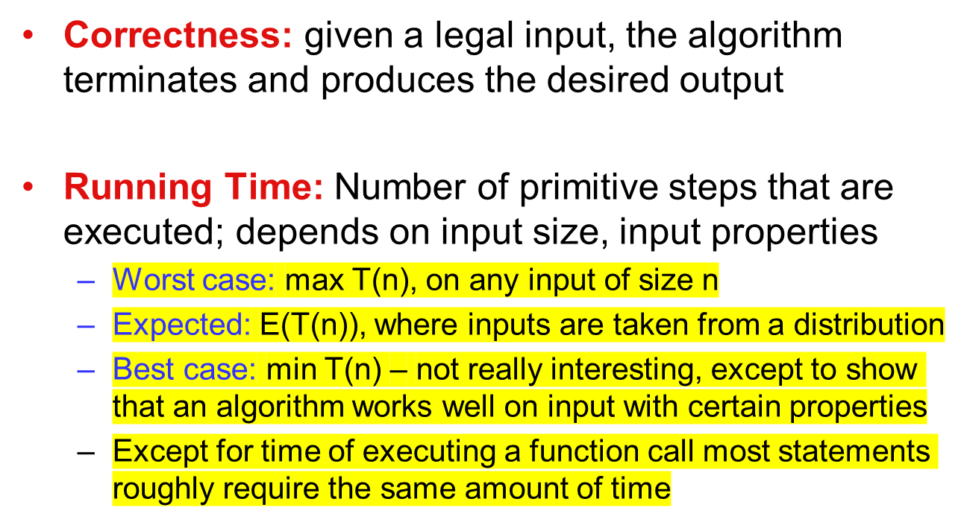
Analysis of an algorithm
Notes:
*important

Slide 42
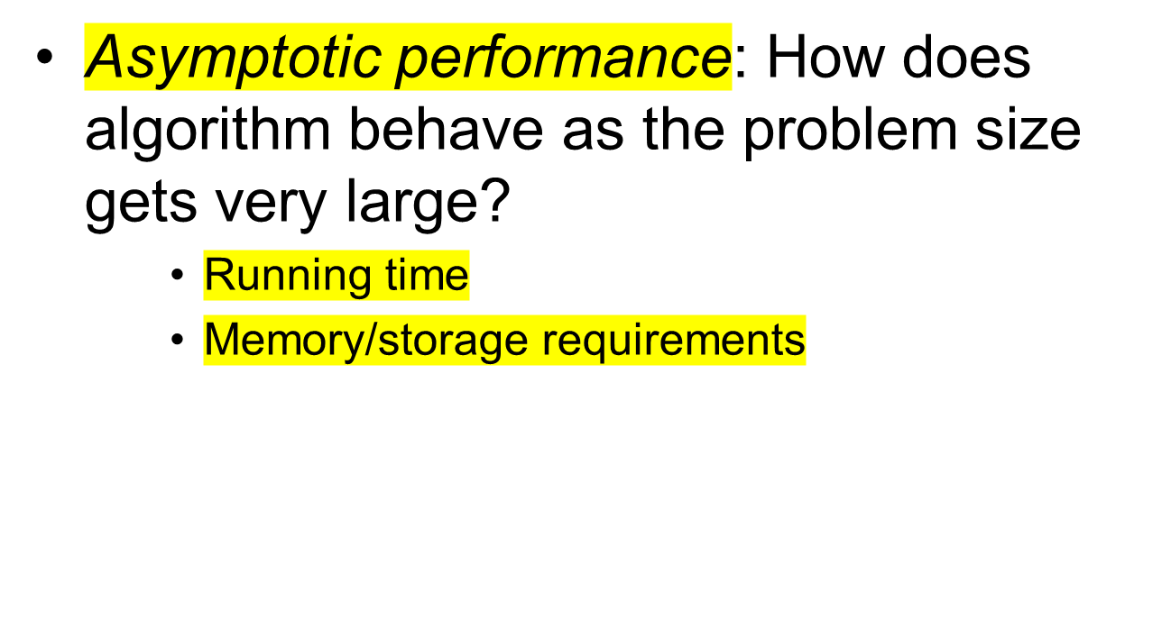
Asymptotic Performance
Notes:
*Asymptotic preformance

Slide 43
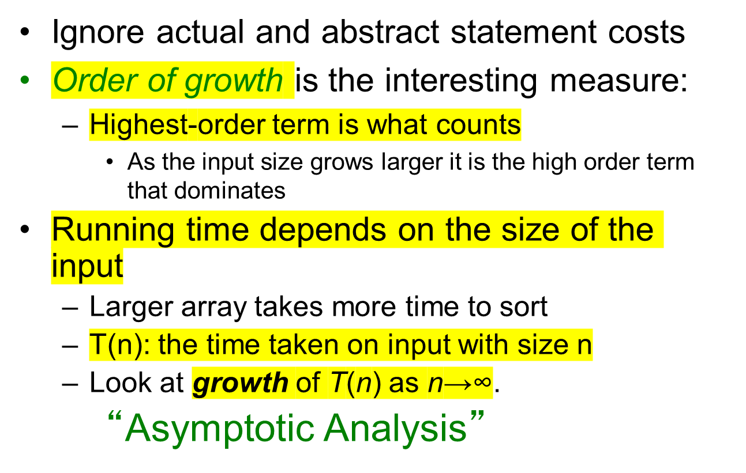
Asymptotic Analysis

Slide 44
Comparison of functions
 | log₂n | n | nlog₂n | n² | n³ | 2^{n} | n!
10 | 3.3 | 10 | 33 | 10² | 10³ | 10³ | 10⁶
10² | 6.6 | 10² | 660 | 10⁴ | 10⁶ | 10³⁰ | 10¹⁵⁸
10³ | 10 | 10³ | 10⁴ | 10⁶ | 10⁹
10⁴ | 13 | 10⁴ | 10⁵ | 10⁸ | 10¹²
10⁵ | 17 | 10⁵ | 10⁶ | 10¹⁰ | 10¹⁵
10⁶ | 20 | 10⁶ | 10⁷ | 10¹² | 10¹⁸
For a super computer that does 1 trillion operations per second, it will be longer than 1 billion years

Slide 45

Practical Complexity
http://fooplot.com/
https://www.desmos.com/calculator

Slide 46

Practical Complexity

Slide 47

Practical Complexity

Slide 48

Practical Complexity

Slide 49
Order of growth
1 << log₂n << n << nlog₂n << n² << n³ << 2^{n} << n!
(We are slightly abusing of the “<<“ sign. It means a smaller order of growth).

Slide 50
Asymptotic notations
O: Big-Oh
Ω: Big-Omega
Θ: Theta
o: Small-oh
ω: Small-omega
Intuitively:
  O is like ≤
  o is like <
  Ω is like ≥
  ω is like >
  Θ is like =

Slide 51
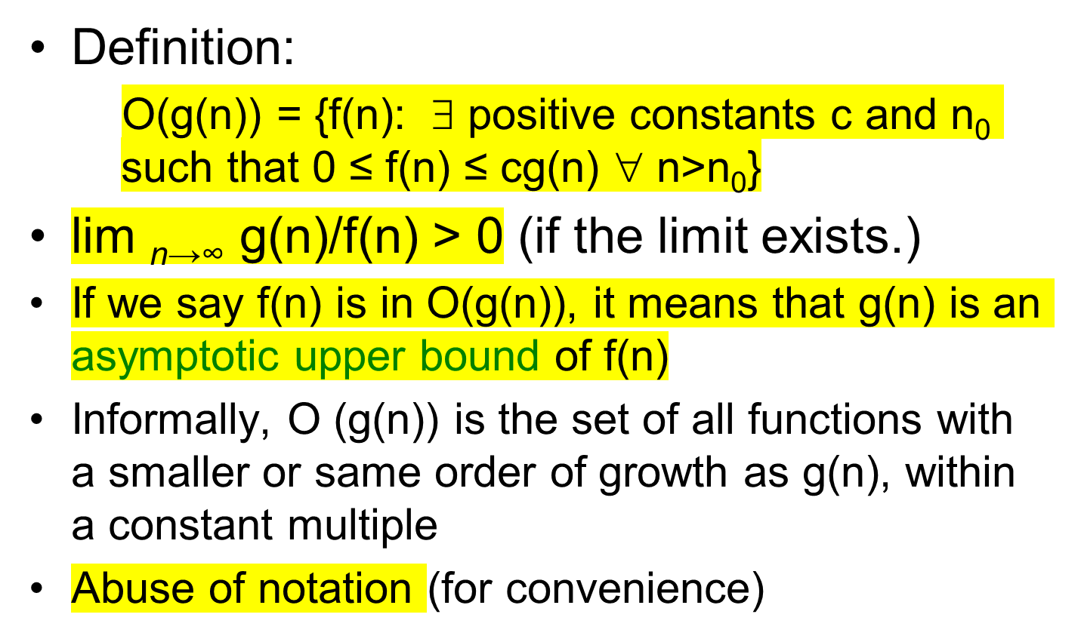
Big-Oh
There exist
For all

Slide 52
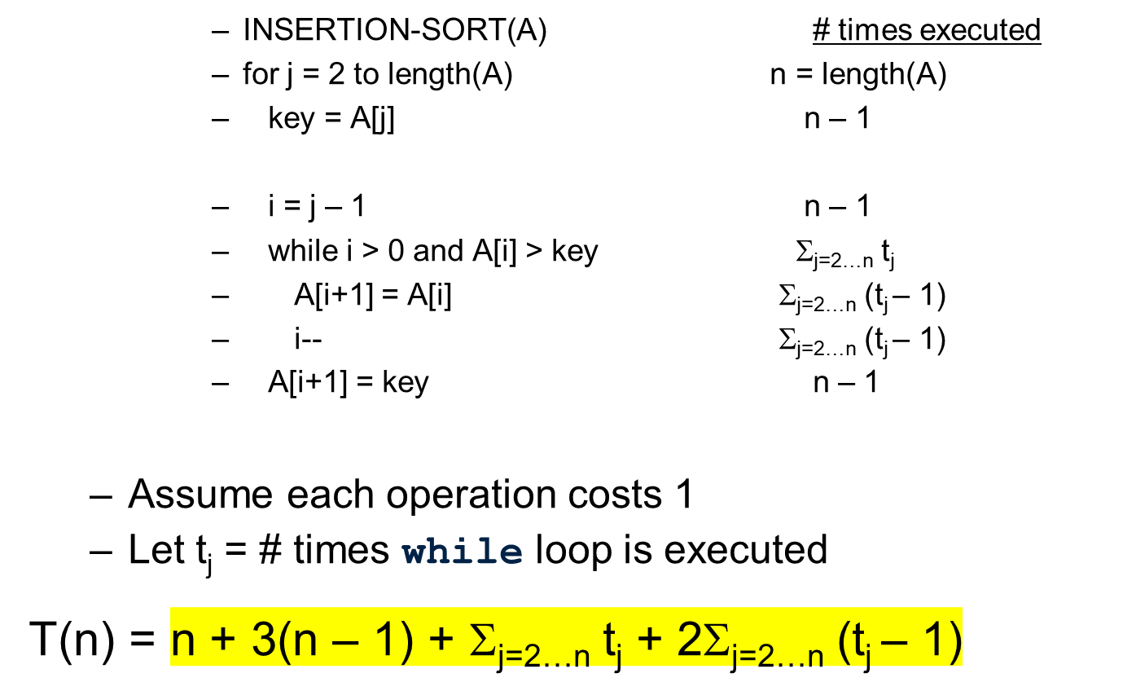
Running Time

Slide 53
Running Time
T(n) = n + 3(n – 1) + Σ_{j=2…n} t_{j} + 2Σ_{j=2…n} (t_{j} – 1)
Best case: Input A is already sorted
Then, t_{j} = 1, for all j
T(n) = 4n – 3 + (n-1) + 0
= 5n - 4
Worst case: Input A is in reverse order: A[1] > … > A[n]
Then, t_{j} = j, for all j
T(n) = 4n – 3 + n(n+1)/2 + n(n-1)
= 3/2 n² + 7/2 n – 3
2
3
6
8
14
16
16
14
8
6
3
2
O(n²)

Slide 54
"Bubbling Up" the Largest Element
Traverse a collection of elements
  Move from the front to the end
  “Bubble” the largest value to the end using pair-wise comparisons and swapping
1 2 3 4 5 6
77
42
35
12
101
5

Slide 55
"Bubbling Up" the Largest Element
Traverse a collection of elements
  Move from the front to the end
  “Bubble” the largest value to the end using pair-wise comparisons and swapping
Swap
1 2 3 4 5 6
42
77
77
42
35
12
101
5

Slide 56
"Bubbling Up" the Largest Element
Traverse a collection of elements
  Move from the front to the end
  “Bubble” the largest value to the end using pair-wise comparisons and swapping
1 2 3 4 5 6
Swap
35
77
42
77
35
12
101
5

Slide 57
"Bubbling Up" the Largest Element
Traverse a collection of elements
  Move from the front to the end
  “Bubble” the largest value to the end using pair-wise comparisons and swapping
1 2 3 4 5 6
Swap
12
77
42
35
77
12
101
5

Slide 58
"Bubbling Up" the Largest Element
Traverse a collection of elements
  Move from the front to the end
  “Bubble” the largest value to the end using pair-wise comparisons and swapping
1 2 3 4 5 6
42
35
12
77
101
5
No need to swap

Slide 59
"Bubbling Up" the Largest Element
Traverse a collection of elements
  Move from the front to the end
  “Bubble” the largest value to the end using pair-wise comparisons and swapping
1 2 3 4 5 6
Swap
5
101
42
35
12
77
101
5

Slide 60
"Bubbling Up" the Largest Element
Traverse a collection of elements
  Move from the front to the end
  “Bubble” the largest value to the end using pair-wise comparisons and swapping
1 2 3 4 5 6
101
42
35
12
77
5
Largest value correctly placed
http://vimeo.com/4315697

Slide 61
The “Bubble Up” Algorithm
index <- 1
last_compare_at <- n – 1
loop
exitif(index > last_compare_at)
if(A[index] > A[index + 1]) then
Swap(A[index], A[index + 1])
endif
index <- index + 1
endloop

Slide 62
Question
What is the worst-case running time of Bubble Sort in terms of big-O? How does Bubble Sort compare to Insertion Sort in running time? Which one is likely to be faster, and why?

Slide 63
Summary
Computational thinking
Importance of algorithm
Insertion sort
Bubble sort
Pseudo code
Running time
Big-O

Slide 64
Acknowledgments
This file is for the educational purpose only. Some materials (including pictures and text) were provided by the colleagues or taken from the Internet at the public domain.

